Slide 1
Build a POV for Root Cause Analysis of
Excess and Obsolete Inventory
Presented By: Varatharaj Kannan S
Date: 08-Nov-2024

Slide 2

Build a POV for Root Cause Analysis of Excess and Obsolete Inventory
Situation
Need
Client: One of the leading chemical companies globally
Client has significant excess and obsolete inventory which is eating into the margins
Currently they have a manual process of identifying the reason for E&O in hindsight and it takes a lot of time and effort in connecting the dots
They have a diagnostic report to identify the volume and value of E&O
Client’s primary requirement is to build a causal model to identify the reasons for E&O and remove the manual intervention
Create a framework to build a decision engine with a forward-looking view to identify SKUs that could potentially result in E&O
Providing right dashboards to all involved stakeholders – Inventory Planners, Warehouse Managers, and Executives/Leadership

Slide 3


Problem Definition & Hypothesis Framing

Slide 4





1.1 Problem Definition and Objectives
Problem Statement:
Main Issue: Significant Excess and Obsolete (E&O) Inventory impacting financial performance and operational efficiency.
This E&O inventory is currently tracked through a manual diagnostic process, which is time-consuming and reactive.
Objectives:
Identify Root Causes: Pinpoint factors driving E&O
Develop Predictive Models: Proactively manage inventory to prevent excess and obsolescence.
Design Decision Engine and Dashboards: Enable real-time, data-driven inventory management.

Slide 5







1.2 Key Questions and Hypotheses (Page 1)
Key Questions:
What factors are strongly correlated with excess and obsolete inventory?
Which SKUs are most at risk of E&O?
How can we proactively manage and prevent E&O?
Hypotheses Summary:
Hypothesis 1: Forecast Inaccuracy is a Primary Driver of E&O.
Rationale: Inaccurate forecasts lead to over-ordering and excess stock.
Expected Outcome: Higher forecast inaccuracy correlates with higher E&O.
Hypothesis 2: Supplier Lead Time Variability Contributes to Excess Inventory.
Rationale: Long or inconsistent lead times increase buffer stocks, leading to excess.
Expected Outcome: SKUs with higher lead time variability are more prone to excess.

Slide 6










1.2 Key Questions and Hypotheses (Page 2)
Hypothesis 3: SKU Lifecycle Phases Influence E&O Probability
Rationale: Products in the Decline phase have higher obsolescence risk.
Expected Outcome: SKUs in Decline have higher obsolete inventory rates.
Hypothesis 4: Demand Seasonality and Subdivision-Specific Trends Contribute to E&O
Rationale: Certain subdivisions (e.g., Agrochemicals) show seasonal demand patterns.
Expected Outcome: SKUs with cyclical demand are more susceptible to E&O.
Hypothesis 5: High Inventory Holding and Write-off Costs Indicate Poor E&O Management
Rationale: High carrying and write-off costs correlate with inefficient inventory planning.
Expected Outcome: SKUs with high holding costs are more likely to become excess.

Slide 7
1.3 Hypothesis Testing Framework
Data Points Used for Testing Hypotheses:
Forecast Accuracy: Measures correlation with E&O to test Hypothesis 1
Lead Time and Supplier Variability: Examines relation to excess stock for Hypothesis 2
SKU Lifecycle Phases: Categorizes products by lifecycle phase for Hypothesis 3
Seasonality: Analyzes demand trends by subdivision for Hypothesis 4
Holding Costs: Evaluates the cost implications of E&O for Hypothesis 5
Expected Outcome of Analysis:
Validate hypotheses to identify main drivers of E&O.
Refine inventory management strategies based on findings.
Data Collection
Data Preparation
Hypothesis Testing
Insights & Validation
Actionable Recommendations

Slide 8


Exploratory Data Analysis

Slide 9
2.1 EDA and Data Preparation Summary
Data Preparation Steps
Missing Values: Imputed or removed missing values to ensure data completeness.
Standardization: Ensured consistent formats for dates, numbers, and categories for uniform analysis.
Outlier Removal: Identified and addressed outliers, especially in demand fluctuation and lead time, to prevent skewed results.
Data Consistency: Aligned units and formats across data sources to maintain data integrity.
Key Findings from EDA
Demand Variability: Significant variability observed in demand across subdivisions, particularly in Industrial Gases and Specialty Chemicals, indicating potential forecasting and stocking challenges.
Forecast Accuracy: Generally high across SKUs, but with notable exceptions. Lower accuracy in specific SKUs suggests areas for targeted forecast improvement.
Seasonal Trends: Clear seasonality in demand for Agrochemicals, with peaks in June and September, and dips in August and December. This highlights the need for dynamic inventory adjustments based on seasonality.

Slide 10
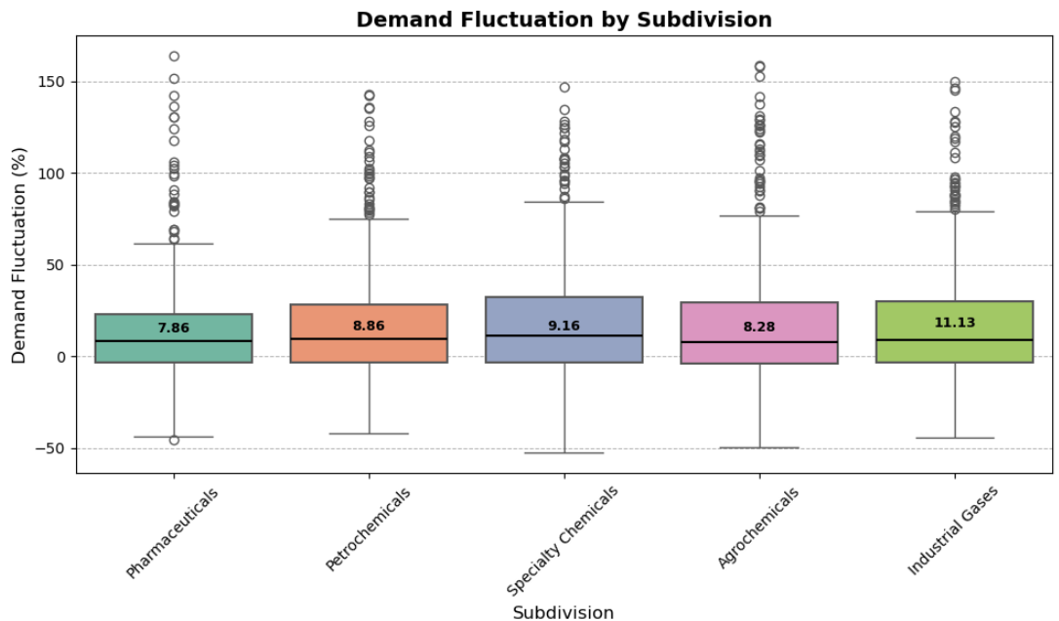
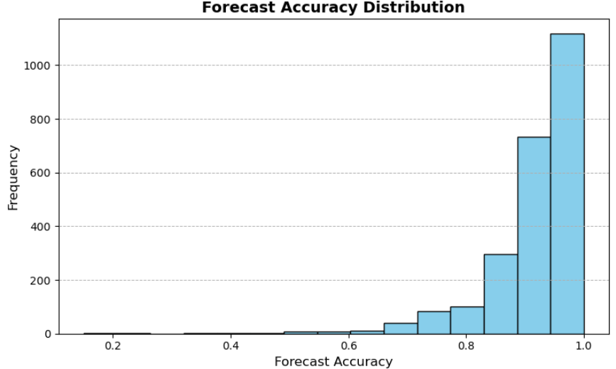
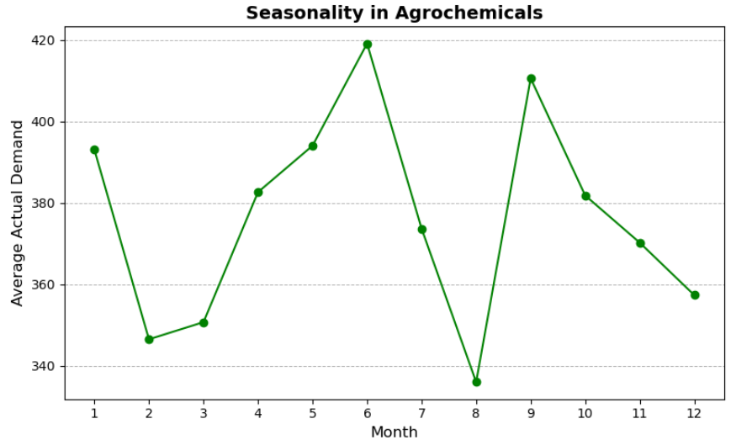
2.2 Summary and Key Insights from EDA (Visualizations)
Demand Fluctuation by Subdivision
Insight: Demand fluctuation varies significantly across subdivisions, with Industrial Gases showing the highest median fluctuation, followed closely by Specialty Chemicals.
Implication: High variability suggests forecasting and inventory challenges. Subdivisions with greater fluctuations may require more adaptive inventory management strategies to mitigate the risk of excess and stockouts.
Forecast Accuracy Distribution
Insight: Forecast accuracy is generally high, with most values close to 1.0, indicating good overall prediction accuracy. However, there are some SKUs with lower accuracy, suggesting potential issues.
Implication: The lower forecast accuracy for specific SKUs could lead to either overstocking or stockouts. Focused improvements in forecasting models or techniques for SKUs with low accuracy could help in optimizing inventory levels.
Seasonality in Agrochemicals
Insight: Demand for Agrochemicals shows clear seasonality, with notable peaks in June and September and drops in August and December.
Implication: This seasonal trend suggests that inventory levels should be adjusted throughout the year, increasing before peak months and reducing during lower-demand months to prevent excess stock and ensure availability.

Slide 11
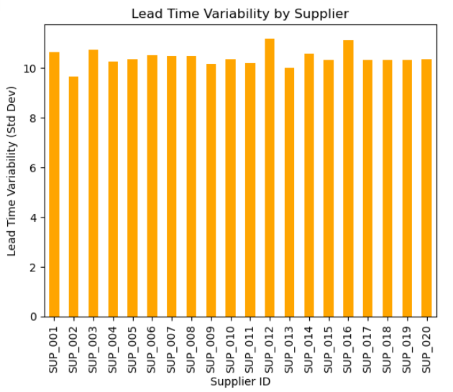
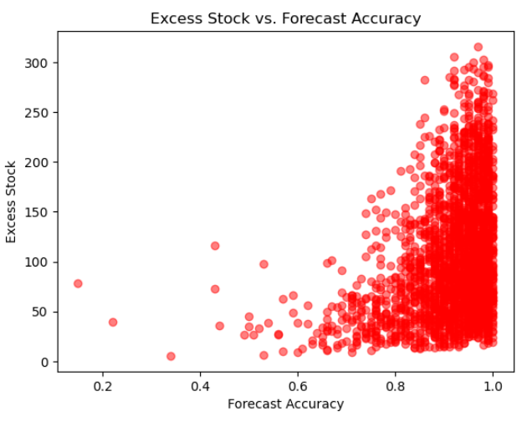
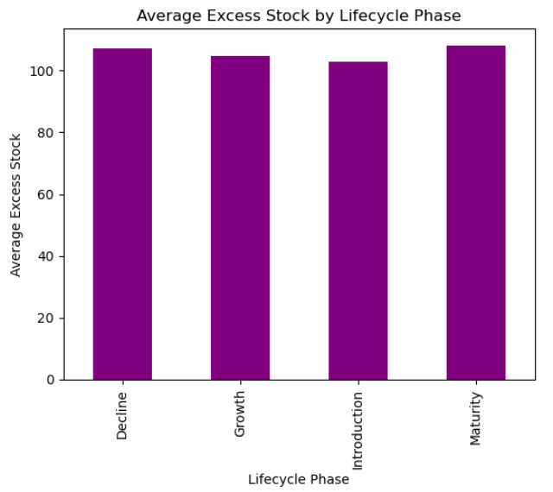
2.2 Supporting Viz. from EDA (Others)

Slide 12
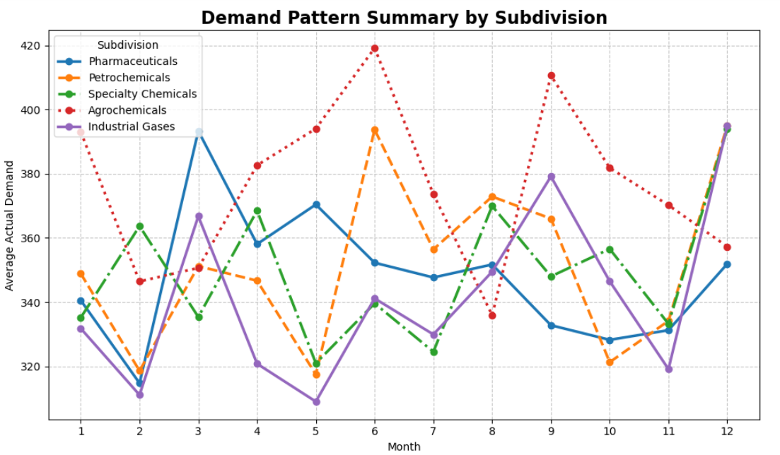
2.3 Demand Pattern summary by Subdivision
Agrochemicals: Noticeable peaks in June and September; dips in August and December, suggesting need for proactive stock management.
Industrial Gases: Peaks in mid-year (June-July) and at year-end, requiring flexible inventory strategies.
Petrochemicals: Multiple peaks throughout the year; agile supply chain adjustments recommended.
Pharmaceuticals: Stable demand with slight fluctuations, ideal for planned buffer stocks.
Specialty Chemicals: Irregular peaks, indicating a need for careful monitoring and adaptable stock policies.

Slide 13


Causal Modeling and Root Cause Analysis

Slide 14
3.1 Define the Target Variable and Key Features
Target Variable (2):
Excess_Stock: If the focus is on understanding drivers of overstock.
Obsolete_Inventory_Value: If the focus is on identifying factors that lead to obsolete or unsellable inventory.
Key Features (7):
Forecast Accuracy: Lower accuracy could lead to excess.
Demand Fluctuation: High variability may indicate volatility and unpredictability.
Lead Time and Lead Time Variability: Longer and more inconsistent lead times require higher safety stock, increasing excess.
Remaining Shelf Life: Shorter shelf life could mean higher risk of obsolescence.
Lifecycle Phase: Products in the Decline phase are more prone to becoming obsolete.
Subdivision and Month (Seasonality): Some subdivisions show clear seasonality that affects demand.
Carrying Cost and Unit Cost: Higher costs may motivate reduction of E&O to avoid unnecessary financial impact.

Slide 15


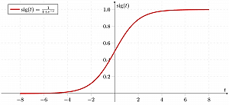

3.2 Model Selection: Choosing the Right Tools for Insight
1. Modeling Approaches Considered:
Regression Models: To predict the amount of excess stock, including Linear Regression and Gradient Boosting for capturing complex relationships.
Classification Models: To classify SKUs as high or low risk of E&O, including Random Forest and Logistic Regression for interpretability and reliability.
2. Why We Chose These Models:
Gradient Boosting Regressor: Strong at identifying non-linear patterns, which helps in understanding the nuanced drivers of excess stock.
Random Forest Classifier: Effective for feature importance and handling imbalanced data (e.g., few high-risk SKUs), providing interpretable results.
Logistic Regression: Simple and interpretable baseline model for classification.
3. Stakeholder Relevance: Models selected allow for accurate, actionable insights, helping stakeholders prioritize high-risk SKUs and take proactive measures.

Slide 16
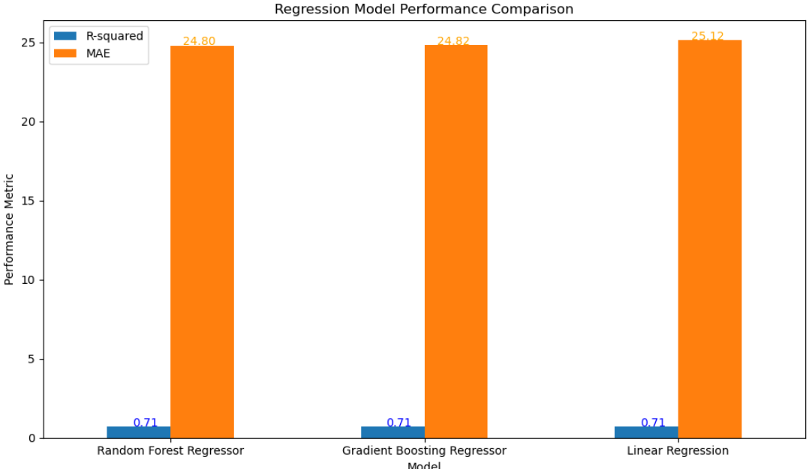
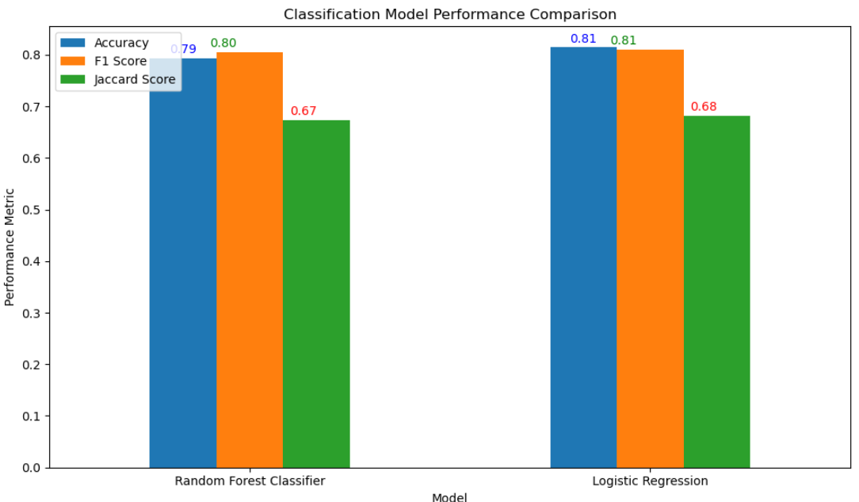
3.3 Model Training & Evaluation: Performance Metrics
Evaluation Metrics Chosen:
Regression (R-squared, MAE): Indicates model fit and prediction error.
Classification (Accuracy, F1 Score, Jaccard Score): Measures accuracy, balance of precision & recall, and overlap of predictions to actual high-risk SKUs.
Training Results Summary:
Best Regression Model: Gradient Boosting Regressor
R-squared: ~0.71 (explains 71% of variation in excess stock).
MAE: ~24.8 units (average prediction error in units of stock).
Best Classification Model: Random Forest Classifier
Accuracy: ~79%
F1 Score: ~0.80 (balancing precision and recall)
Interpretation of Results: Our chosen models capture complex relationships effectively (Gradient Boosting), while also identifying high-risk SKUs reliably (Random Forest Classifier).

Slide 17
3.4 Model Interpretation & Insights for Decision-Making
Key Drivers Identified by the Model:
High Carrying Cost - Drives excess stock risk significantly; reduce carrying costs for high-risk SKUs.
Demand Variability - Highly volatile demand SKUs require dynamic stock adjustments.
Forecast Accuracy - Low forecast accuracy correlates with high E&O; improving accuracy for high-value SKUs is essential.
Lead Time & Variability - Extended or inconsistent lead times increase the likelihood of overstock; suggests need for supplier collaboration.
Lifecycle Stage - SKUs in decline phase are more prone to obsolescence, suggesting markdowns and exit strategies.
Actionable Insights:
Adjust Reorder Policies: For SKUs with high carrying costs, set lower reorder points or implement just-in-time practices.
Demand-Based Stock Adjustments: Use rolling averages for demand forecasts in high-fluctuation SKUs.
Supplier Collaboration: Work with suppliers to reduce lead time variability, potentially through buffer agreements or adjusted contracts.
Lifecycle Management: Implement markdown strategies for SKUs nearing end of life to minimize obsolescence.

Slide 18
3.5 Model Limitation
1. Data Quality and Availability 🔍
Challenge: Missing values could impact prediction reliability.
Impact: Seasonal trends may be underrepresented due to limited historical data.
2. Feature Engineering Constraints
Challenge: Lagged variables and rolling averages assume consistency.
Impact: Erratic demand patterns may not be fully captured, affecting prediction accuracy. 📊
3. Model Interpretability
Challenge: Tree-based models (e.g., Gradient Boosting, Random Forest) are less interpretable.
Impact: Limited transparency for stakeholders, potentially affecting trust in predictions.
4. Sensitivity to Hyperparameters
Challenge: Risk of overfitting and parameter instability.
Impact: Regular tuning is essential to avoid overfitting and maintain long-term robustness.
5. Generalizability
Challenge: Models are specific to current SKUs and subdivisions.
Impact: New or unseen categories may limit model applicability; frequent retraining is required.
6. Anomaly and Outlier Sensitivity
Challenge: High demand variability and market disruptions can skew predictions.
Impact: Extreme events and outliers may not be fully captured, impacting inventory decisions.
7. Limited Real-Time Adaptability
Challenge: Models are not automatically updated in real-time.
Impact: Insights could become outdated without scheduled retraining.
Key takeaway message: “Continuous data updates and interpretability improvements are key to maximizing the model's effectiveness.”

Slide 19


Model Interpretation and Actionable Insights

Slide 20
4.1 Key Drivers of E&O Inventory
S No | Feature | Importance | Interpretation | Actionable Insight
1 | Carrying Cost | Highest (0.935, 0.503) | High carrying costs drive E&O, increasing the financial burden. | Reduce stock for high-cost items, adjust reorder points & safety stock levels.
2 | Demand Fluctuation | High (0.039, 0.123) | High variability leads to overstocking due to unpredictable demand. | Use dynamic forecasting, adjust safety stock based on demand volatility.
3 | Forecast Accuracy | Moderate (0.009, 0.092) | Low accuracy causes over-ordering to avoid stockouts. | Improve forecasts for volatile or high-cost SKUs; align inventory with demand.
4 | Unit Cost | Moderate (0.006, 0.084) | High-cost items contribute more to financial impact of E&O. | Tighten controls on high-cost SKUs, set stricter reorder and safety stock policies.
5 | Lead Time Days | Moderate in RF Classifier (0.073) | Long, variable lead times drive excess stock. | Collaborate with suppliers to reduce variability; adjust safety stock as needed.
6 | Shelf Life | Moderate in RF Classifier (0.061) | Short shelf life increases obsolescence risk. | Discount or reduce orders for items nearing end of shelf life to prevent obsolescence.
7 | Subdivision | Low to moderate (0.003, 0.035) | Demand patterns vary by subdivision (e.g., seasonality in Agrochem). | Adjust inventory based on seasonal demand for subdivisions like Agrochemicals.
8 | Lifecycle Phase | Lowest (0.0007, 0.029) | Lifecycle phase has a minor impact on E&O risk in this dataset. | Monitor Decline phase SKUs but prioritize direct drivers (e.g., cost, demand).

Slide 21
4.2 Drivers of E&O Inventory
High
Priority
Low
Priority
Unit Cost
Lead Time
Shelf Life
Subdivision
Lifecycle Phase
Moderate
Priority
Carrying Cost
Demand fluctuation
Forecast Accuracy

Slide 22
4.3 Key Drivers of E&O Inventory (Feature Importance Analysis)
Carrying Cost (Top Driver)
Impact: Strongly linked to excess and obsolescence.
Action: Focus on reducing inventory for high-cost SKUs by adjusting safety stock and reorder points.
Demand Fluctuation (High Influence)
Impact: High variability in demand leads to overstocking.
Action: Implement dynamic forecasting and flexible stock policies for volatile items.
Forecast Accuracy (Moderate Influence)
Impact: Lower forecast accuracy increases excess risk.
Action: Improve demand forecasting, especially for high-risk SKUs.
Unit Cost (Moderate Influence)
Impact: Higher unit costs increase the financial impact of E&O.
Action: Set stricter inventory controls on high-cost items.
Lead Time Variability (Moderate Influence)
Impact: Inconsistent lead times drive up safety stock needs.
Action: Collaborate with suppliers to stabilize lead times or adjust safety stock levels accordingly.

Slide 23


Implementation & Monitoring Plan

Slide 24
5.1 Recommendations & Monitoring Plan
Recommendation | Action | Monitoring
Optimize Inventory for High-Cost SKUs | Adjust reorder points and safety stock levels for high-carrying-cost SKUs to minimize holding costs. | Track monthly carrying costs and assess E&O levels for targeted SKUs to evaluate financial impact.
Implement Dynamic Demand-Based Adjustments | Use flexible forecasting models for SKUs with high demand variability; adjust safety stock policies to match demand changes. | Conduct quarterly reviews of forecast accuracy and adjust as needed to maintain responsiveness.
Collaborate with Suppliers to Manage Lead Time Variability | Work with suppliers to stabilize lead times; for high variability, negotiate reliable schedules or adjust buffer stock. | Perform biannual lead time reviews and adjust safety stock policies based on supplier performance.
Lifecycle and Shelf-Life Management for Decline-Phase Products | Implement markdown strategies and inventory reductions for products in Decline phase to minimize obsolescence. | Monthly review of SKUs in Decline phase, ensuring inventory levels align with projected lifecycle stages.

Slide 25





5.2 Recommendations for Reducing E&O Inventory
Enhance Forecasting Models:
Action: Focus on improving forecast accuracy for SKUs with high demand variability, using advanced forecasting methods that consider seasonality and trends.
Expected Impact: Reduced excess inventory and improved alignment with real demand.
Optimize Safety Stock with Dynamic Adjustments:
Action: Implement dynamic safety stock calculations that account for supplier lead time variability.
Expected Impact: Lower excess stock levels and reduced carrying costs by aligning inventory with actual supplier performance.
Proactive Lifecycle Management:
Action: Prioritize SKUs in the Decline phase for inventory reduction strategies, such as phased-out production or targeted discounting.
Expected Impact: Minimized obsolescence costs and reduced financial risk from unsellable stock.
Seasonal Stock Adjustments for High-Variability Subdivisions:
Action: Adjust inventory levels for seasonal products, based on historical demand peaks and troughs.
Expected Impact: Reduced inventory during low-demand periods, minimizing excess stock and obsolescence.
Implement Real-Time Dashboards and Alerts:
Action: Develop dashboards to track forecast accuracy, lead time variability, and SKU lifecycle status, with alerts for SKUs nearing risk thresholds.
Expected Impact: Enables proactive management, empowering planners to take timely action to prevent excess and obsolete inventory.

Slide 26
5.3 Implementation Roadmap
Phase
Enhance Forecasting Accuracy
Dynamic Safety Stock Adjustments
Proactive Lifecycle Management
Seasonal Stock Adjustments
Dashboard Development and Alert Integration
Actions
Integrate advanced forecasting methods, focusing on seasonality and trends.
Integrate advanced forecasting methods, focusing on seasonality and trends.
Prioritize SKUs in Decline phase for inventory reduction strategies, like phased production, targeted discounting.
Adjust inventory levels for seasonal products based on historical demand peaks and troughs.
Develop real-time dashboards and alerts for tracking forecast accuracy, lead time variability, and lifecycle status.
Goals
Improve accuracy for high-variability SKUs, aligning stock with demand more precisely.
Reduce carrying costs by better aligning stock levels with real supplier performance.
Minimize the financial risk of unsellable stock due to obsolescence.
Minimize excess stock during low-demand periods to avoid obsolescence.
Enable proactive management of SKUs nearing risk thresholds.

Slide 27





5.4 Expected Benefits
Financial Impact: Reduced inventory carrying costs and minimized obsolescence, improving profitability.
Operational Efficiency: Enhanced alignment of inventory with real demand, reducing waste and excess stock.
Risk Management: Improved visibility into SKU risks, allowing for more proactive, strategic decision-making.
Adaptability: Faster response times to demand and lifecycle changes, enabling a more resilient supply chain.
Data-Driven Insights: Real-time dashboards empower the team with actionable insights, improving inventory control.

Slide 28
Deliverable Dashboard (Power BI)

Slide 29
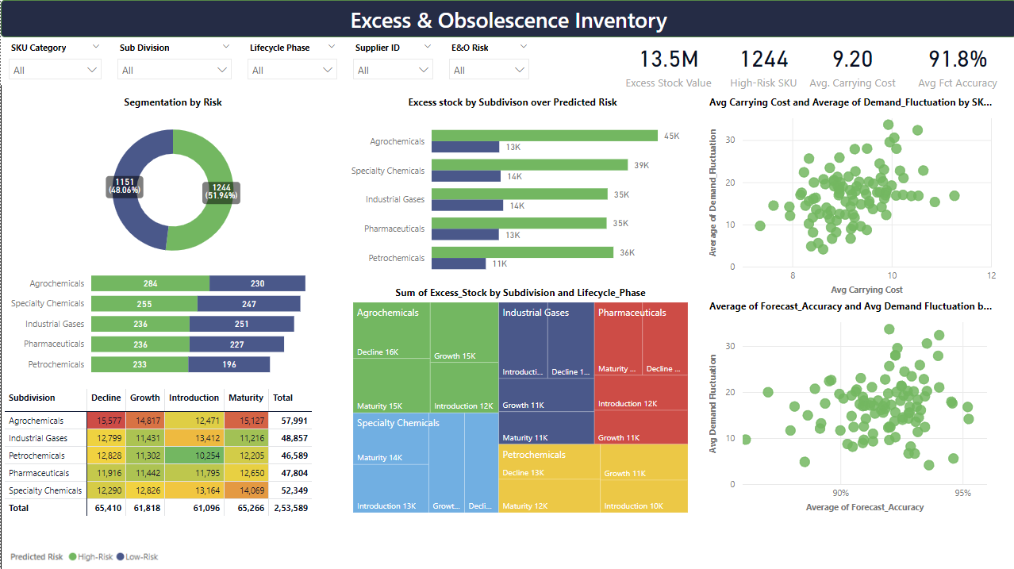

Slide 30
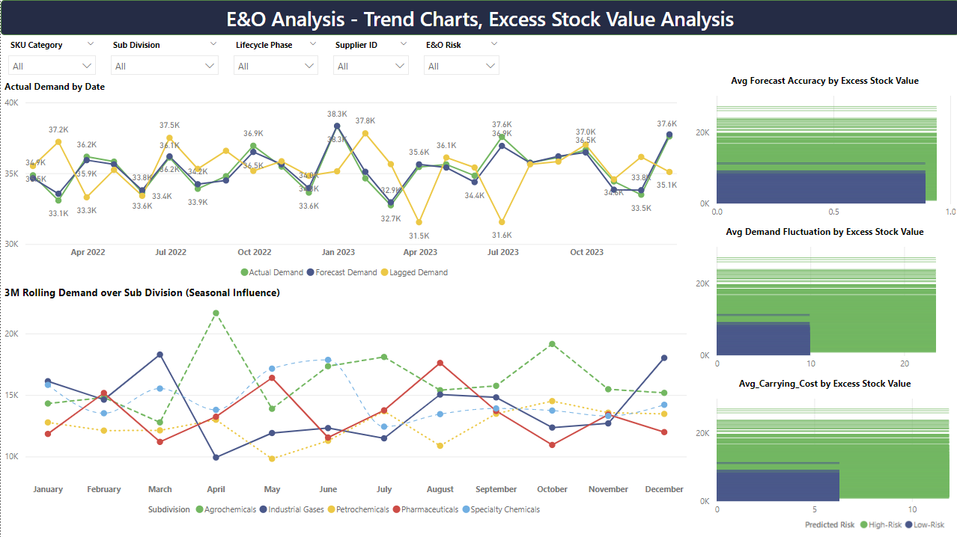

Slide 31
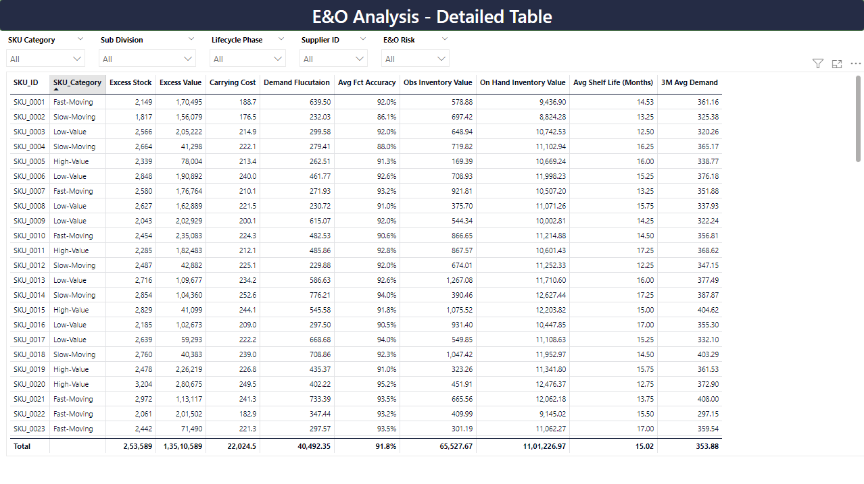

Slide 32


